Slide 1
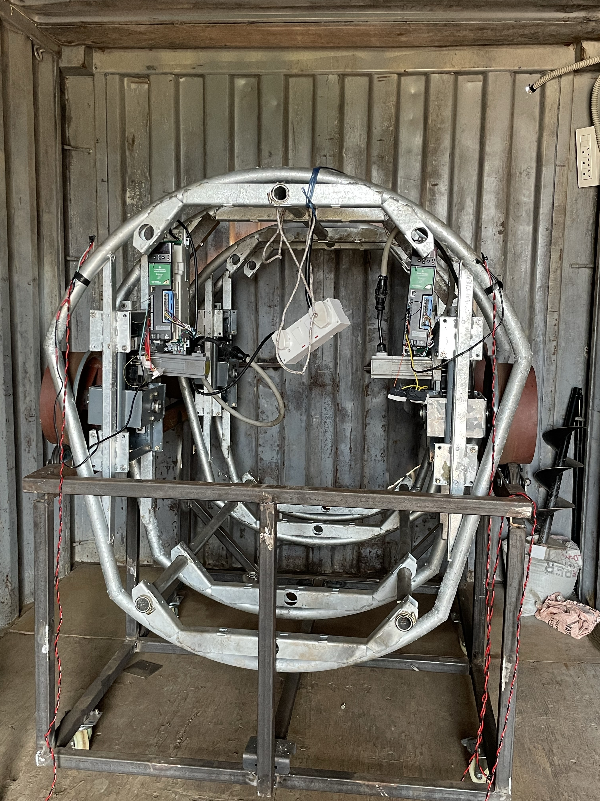
Synchronising PMSM motors

Slide 2
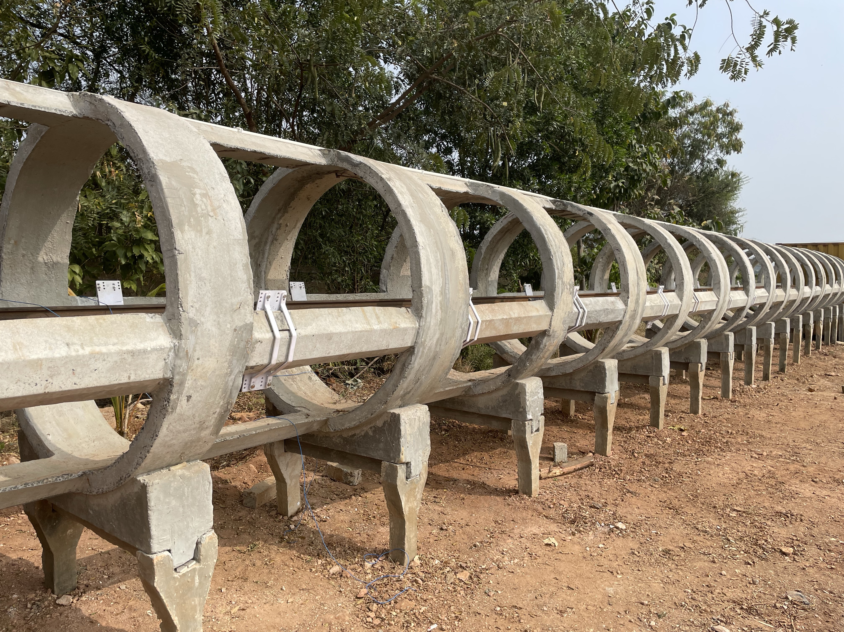
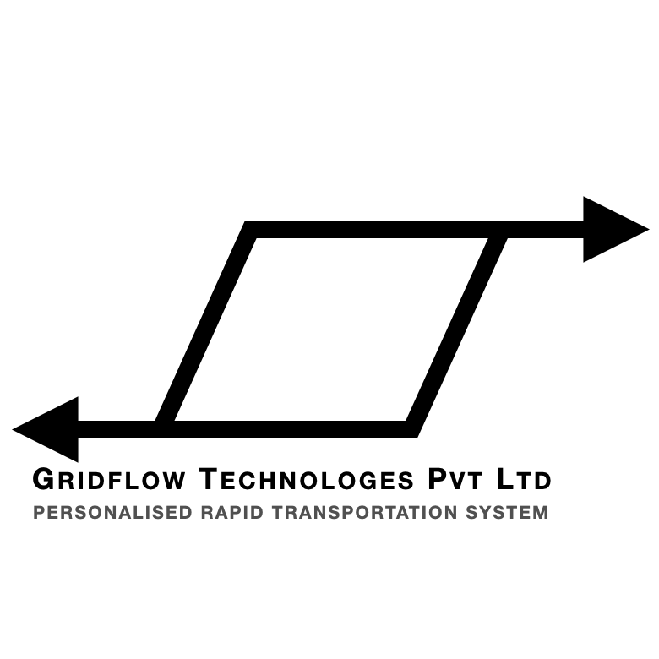

Slide 3
Problem Statement
Design a synchronisation mechanism for two motors with distinct characteristics
and controllers to ensure coordinated operation in a straight track

Slide 4
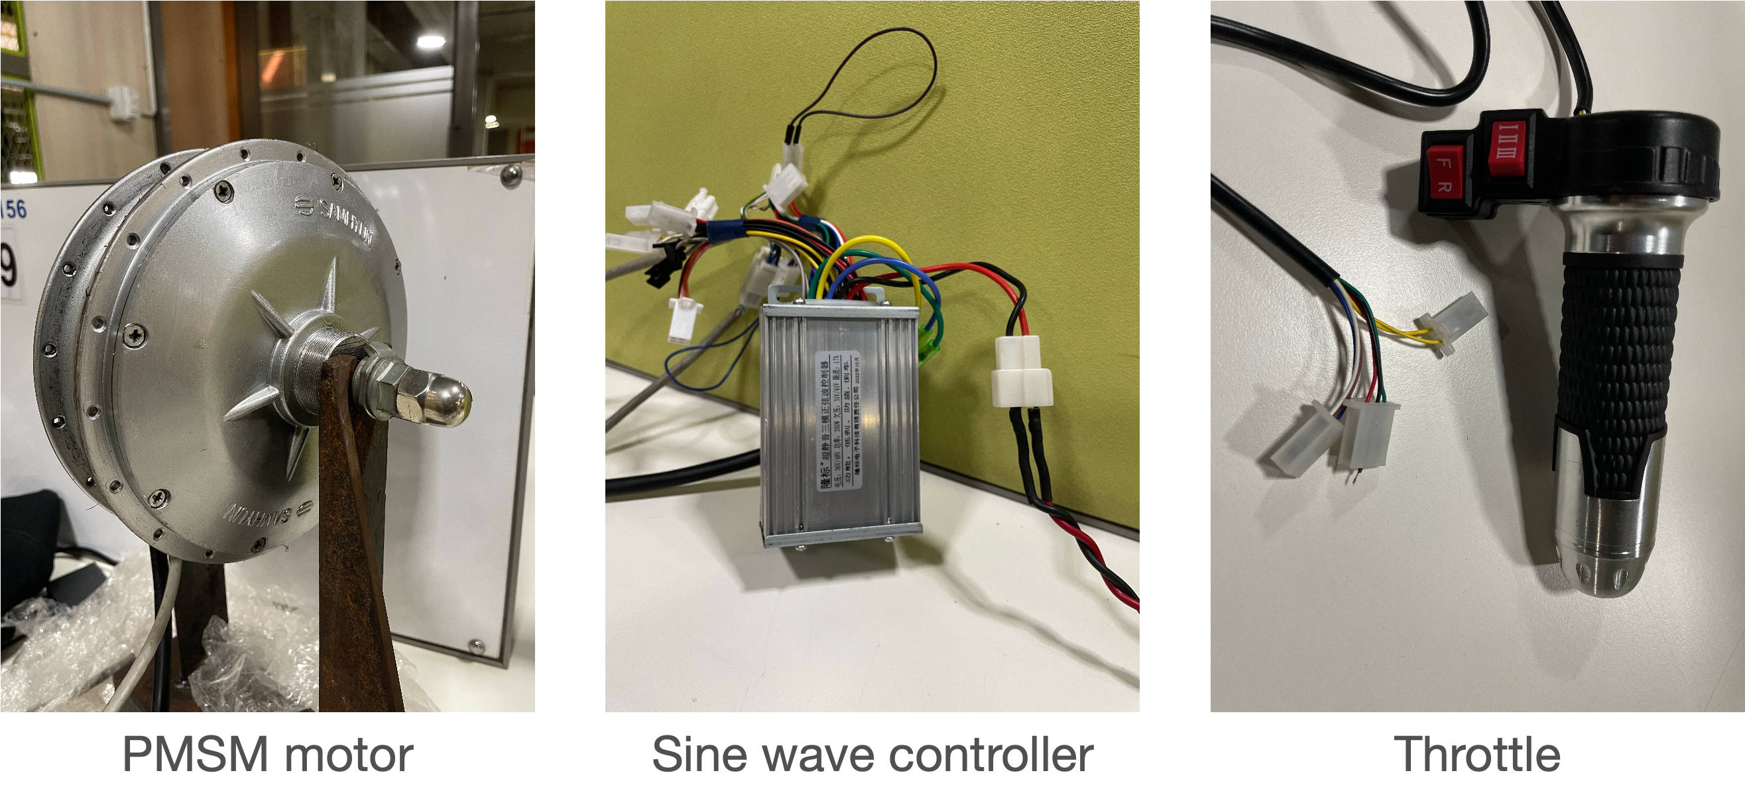

Slide 5
Prerequisites
• Motors and motor drivers
• Power supply 48v
• Power computation board
• Motor speed computation board
• Load cell
• Tachometer
• Structure to mount the motor

Slide 6
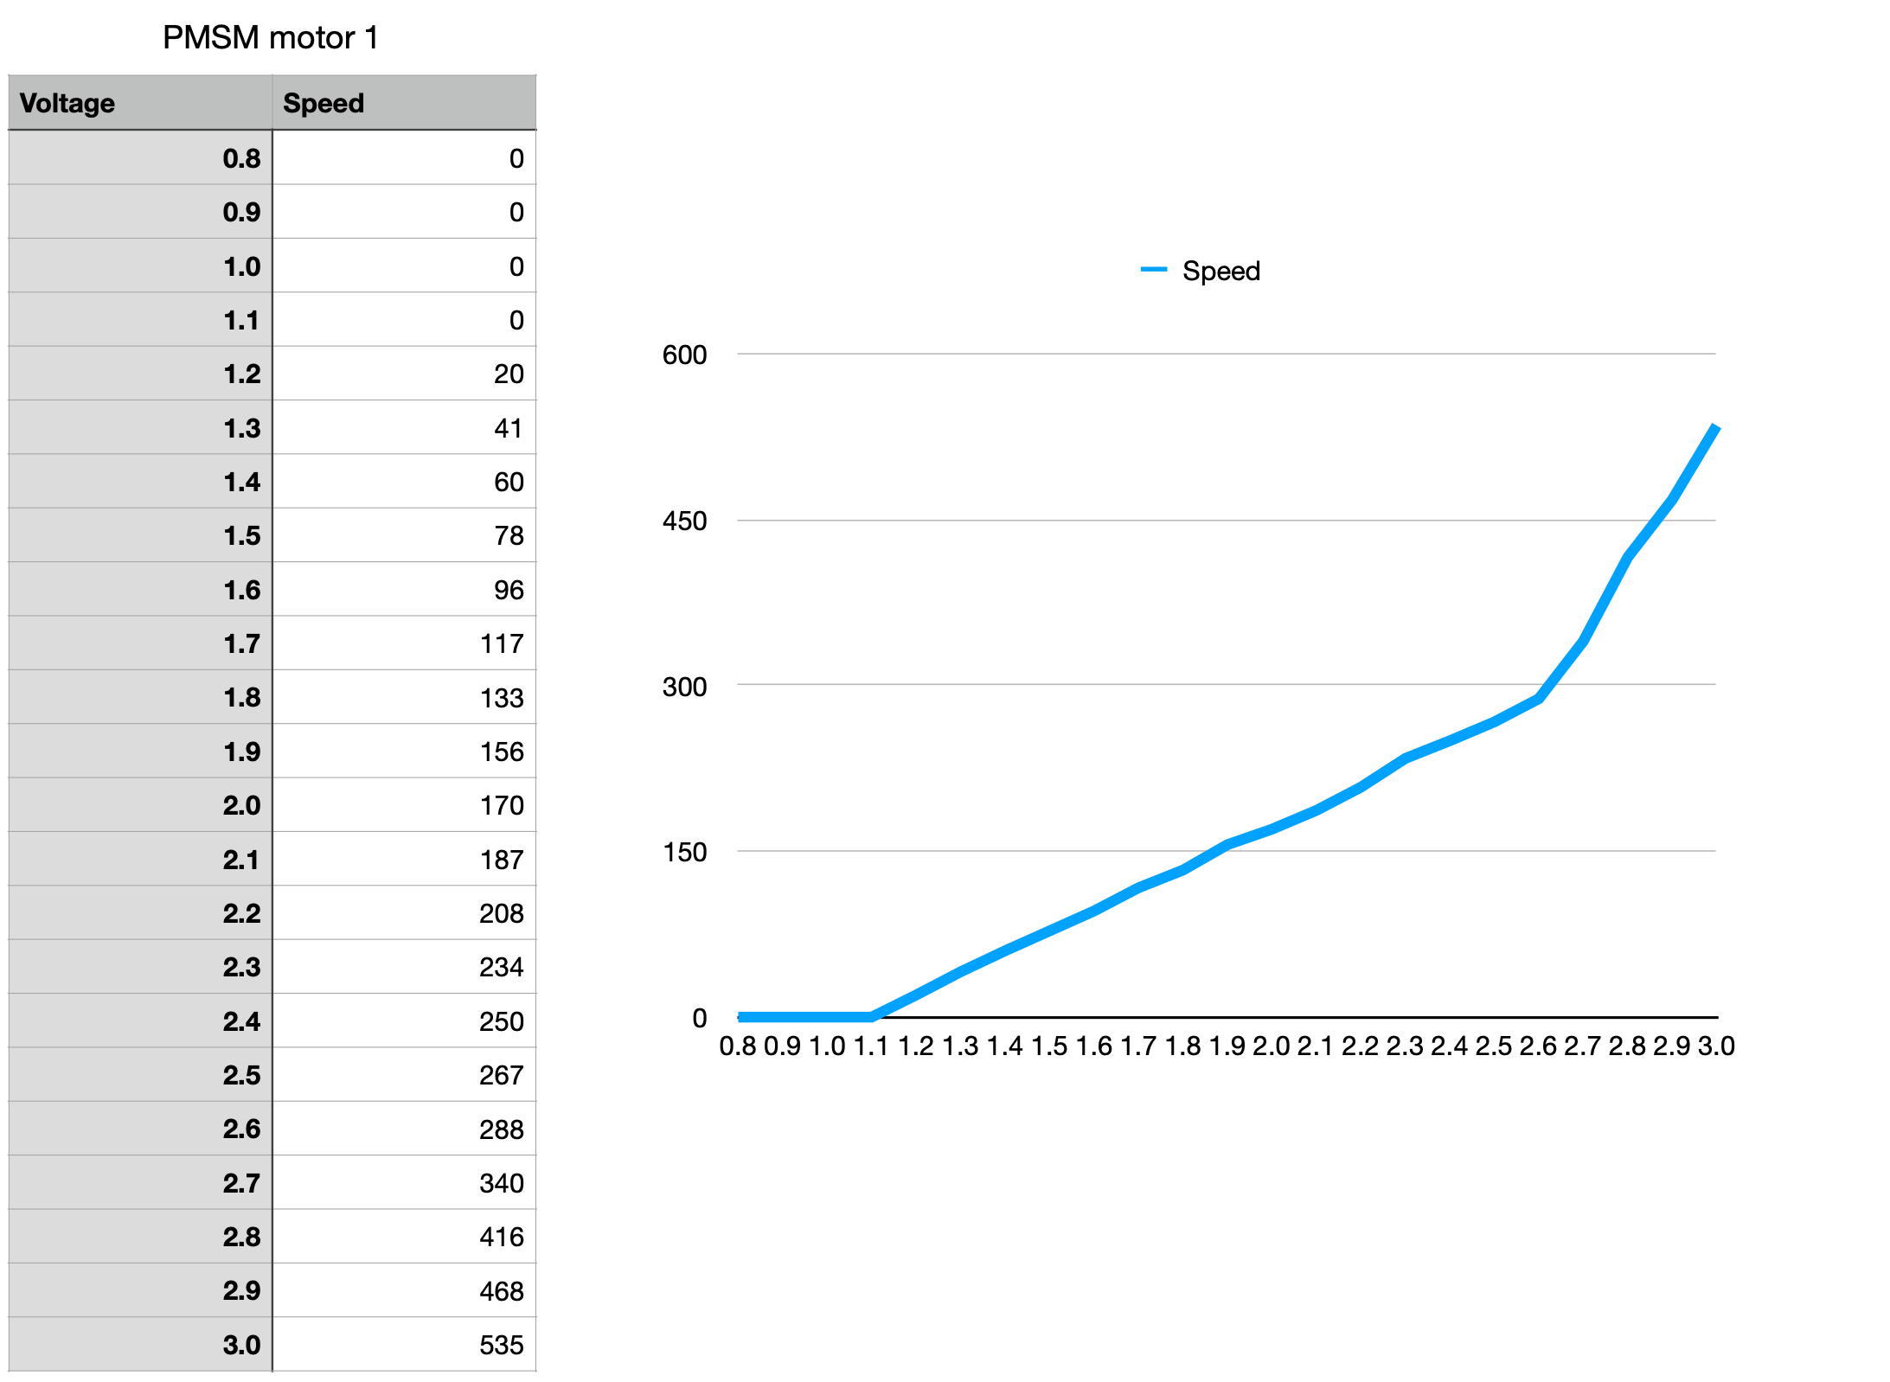
Voltage vs speed no load

Slide 7
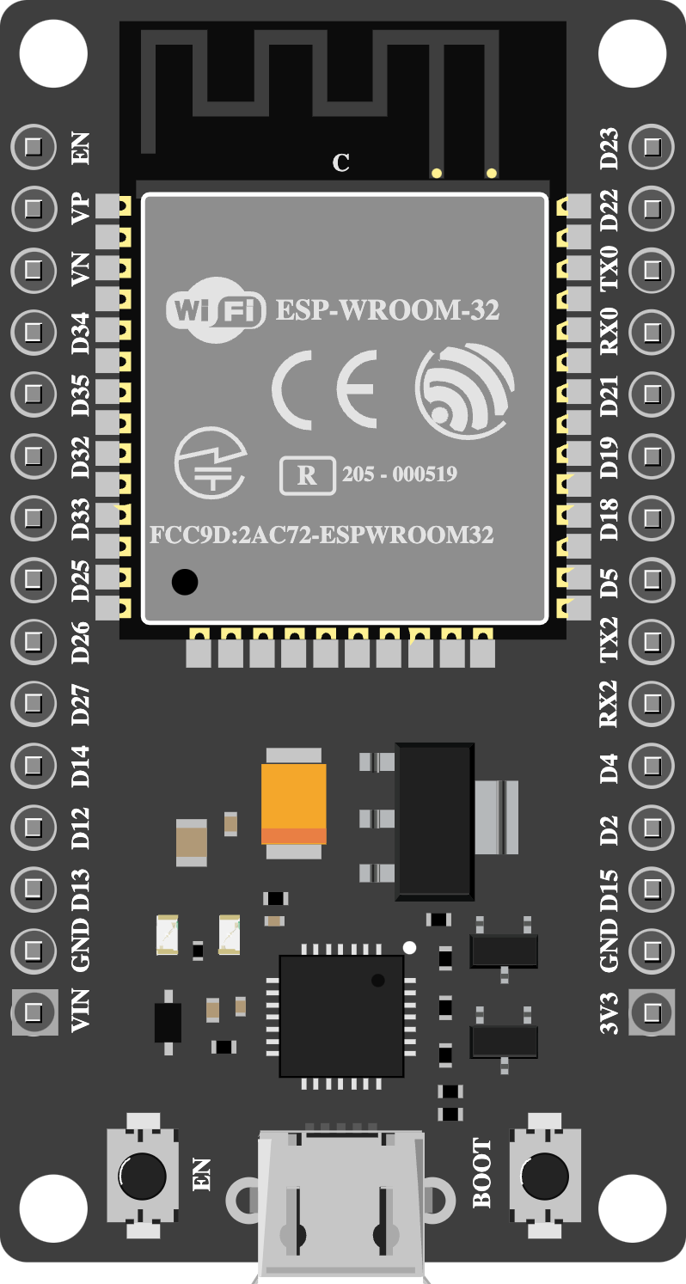
Hall sensor reading

Slide 8
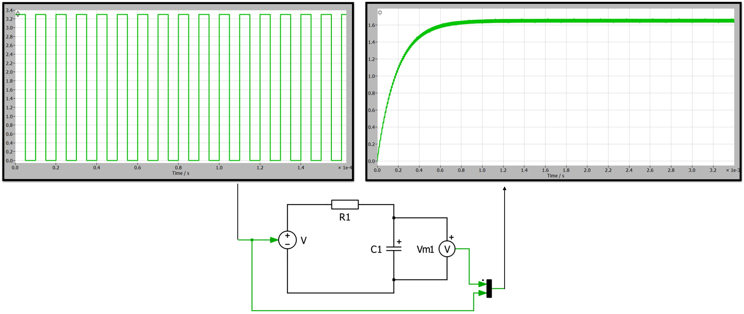
RC Filter

Slide 9
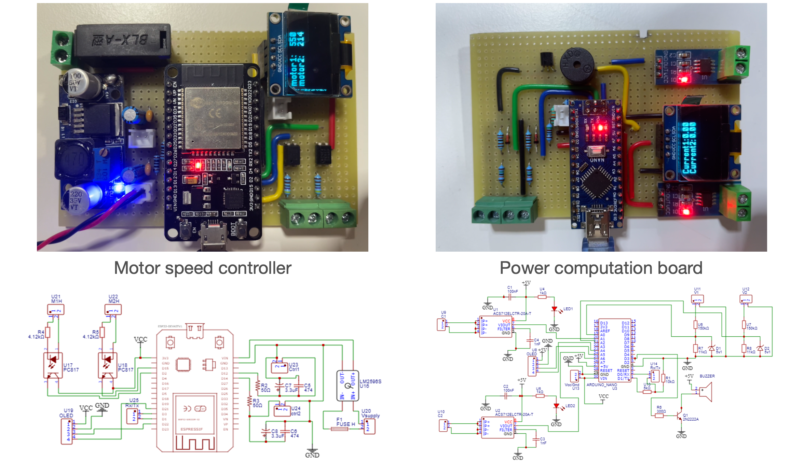

Slide 10
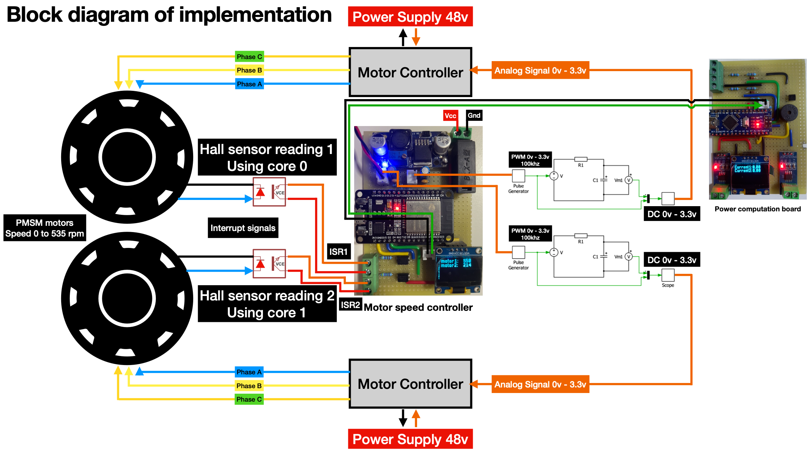

Slide 11
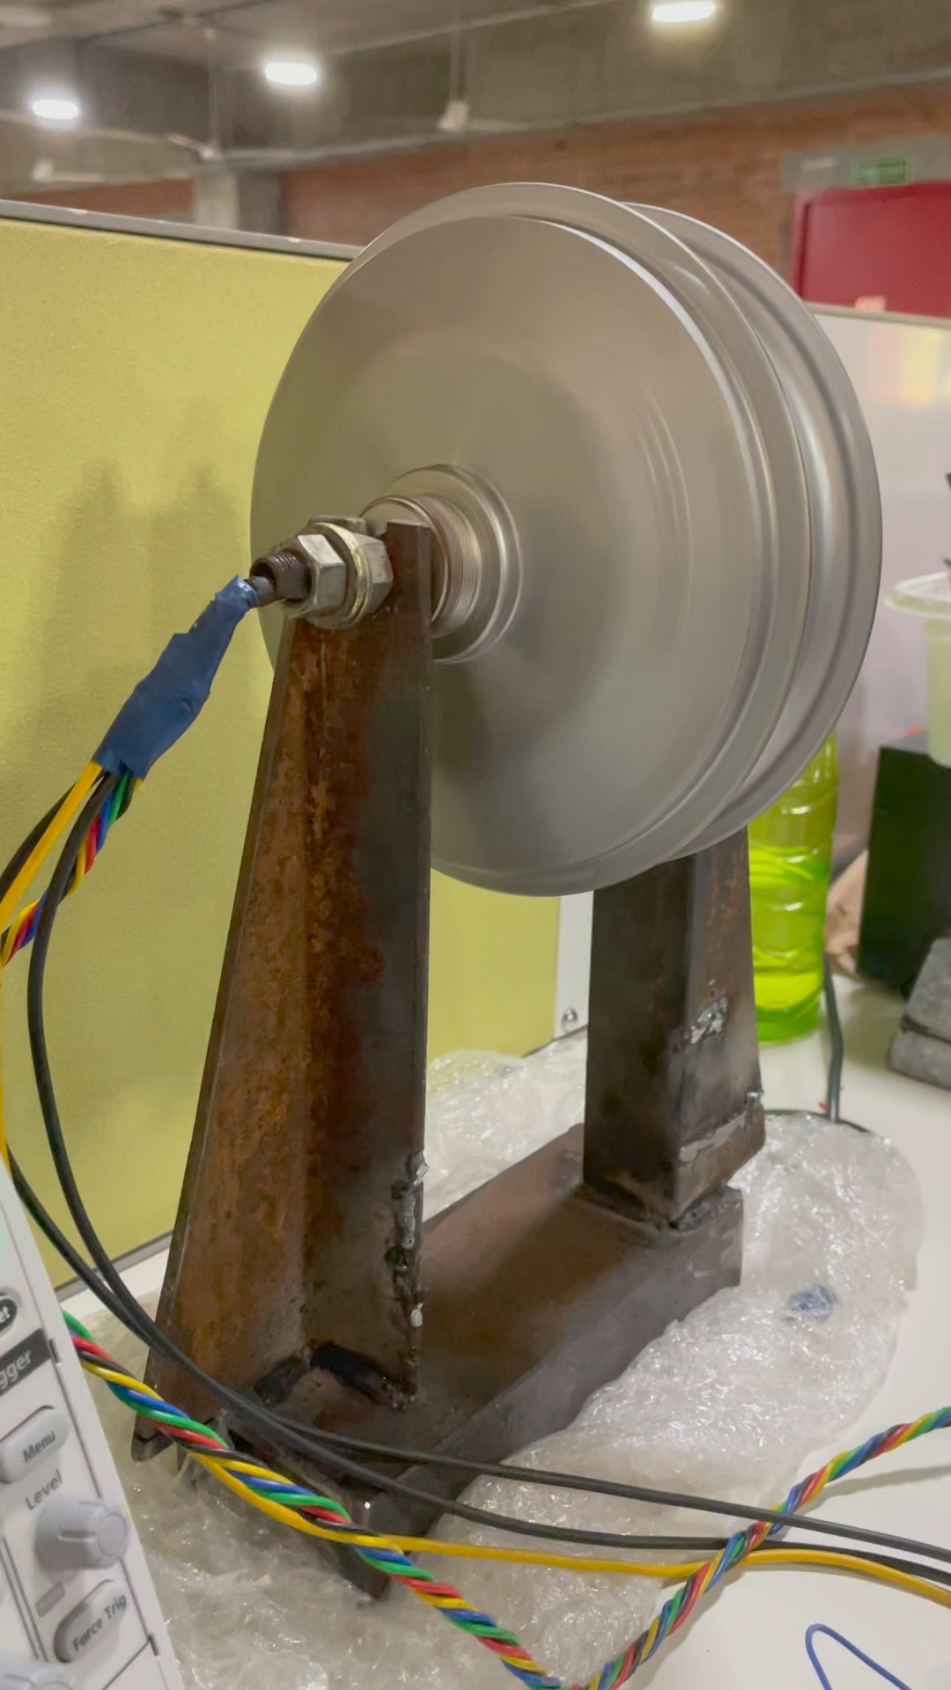
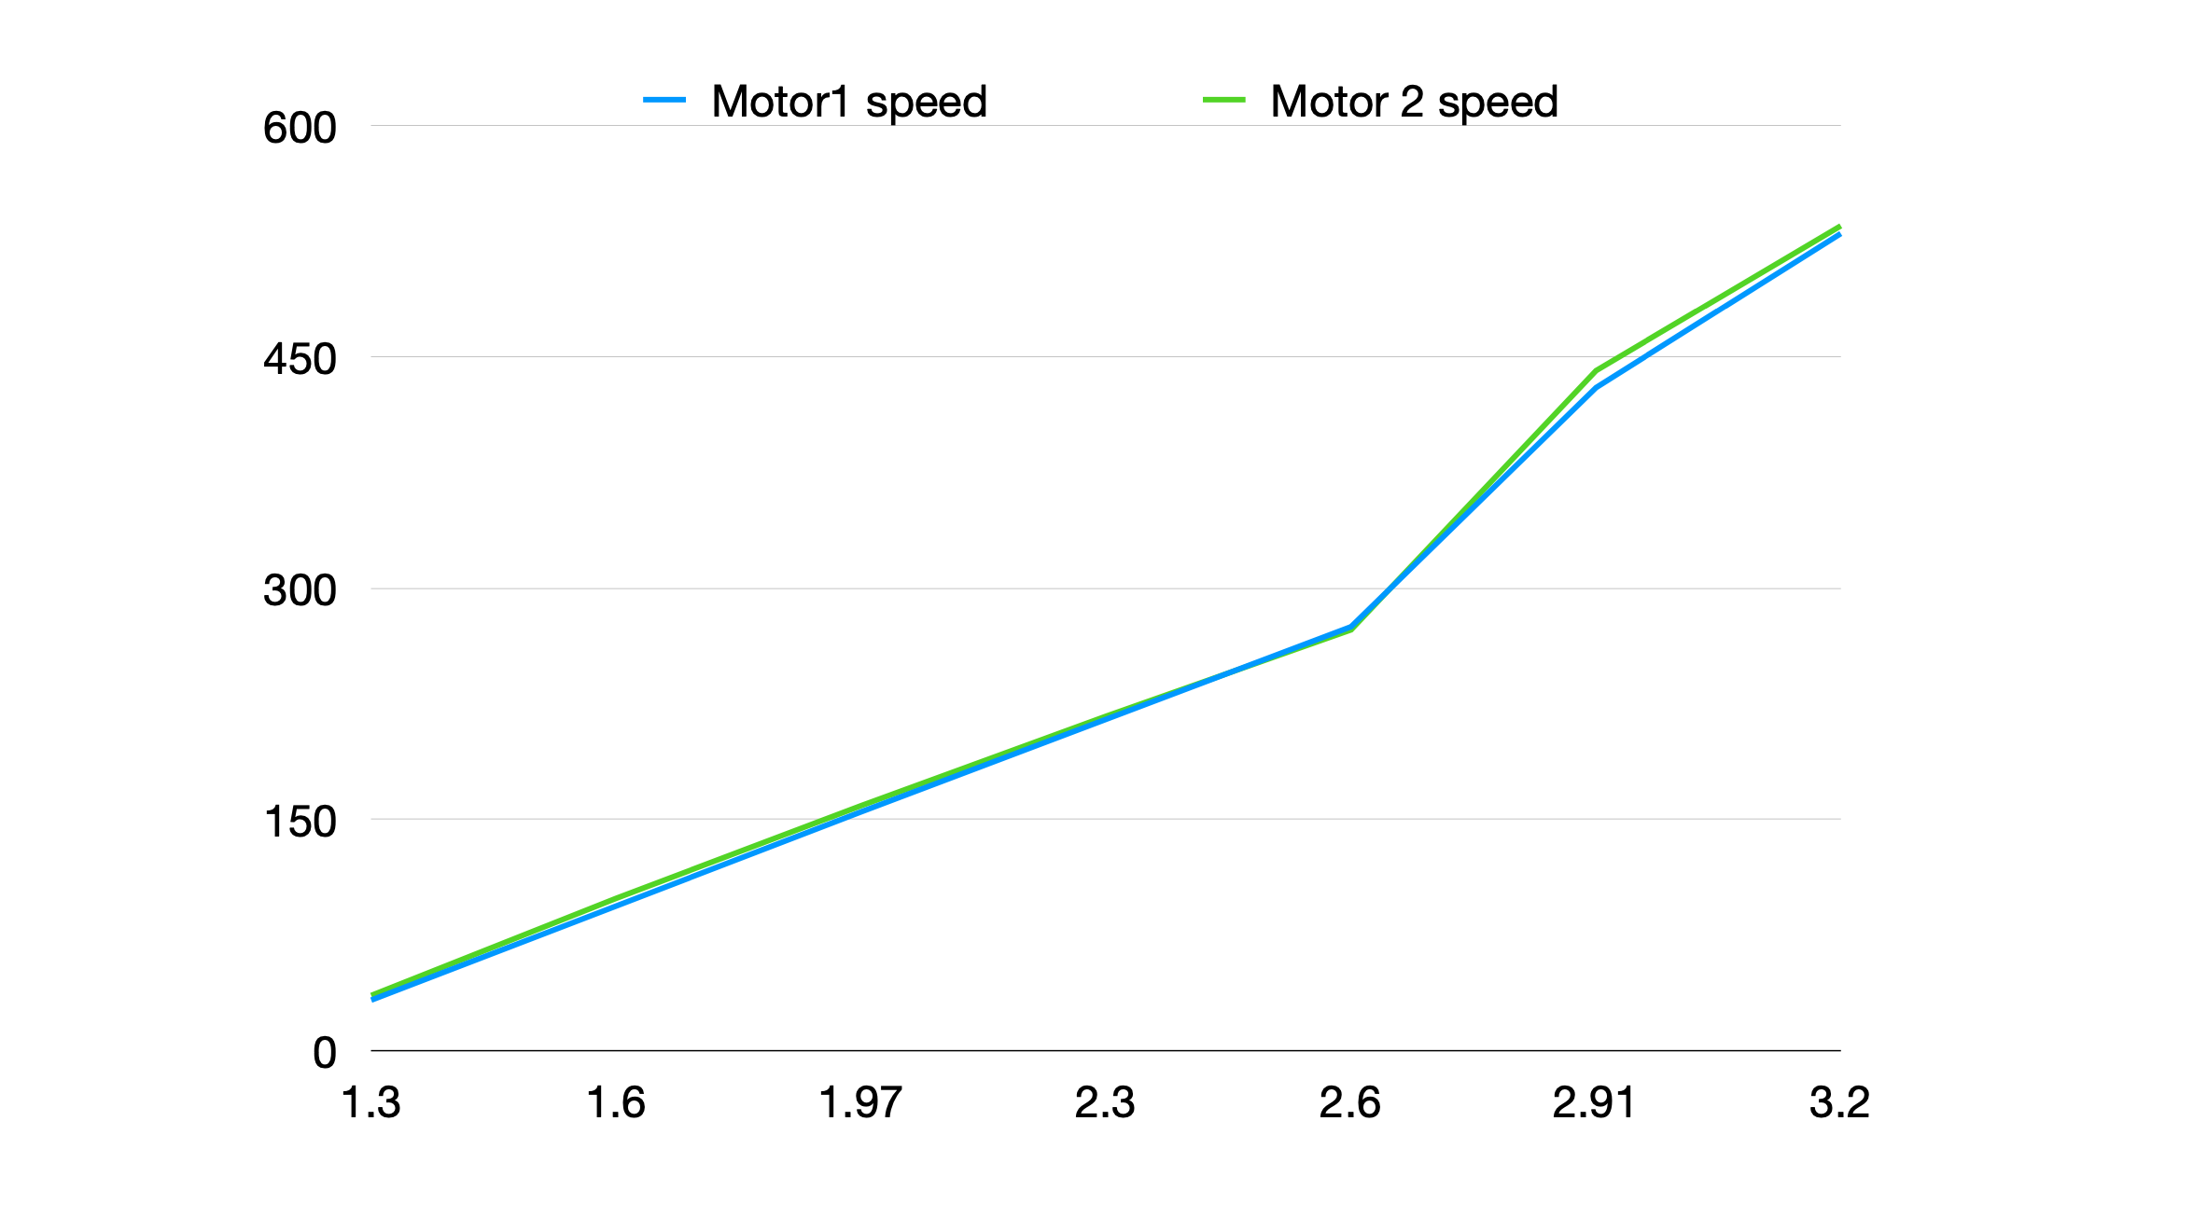
No load test

Slide 12
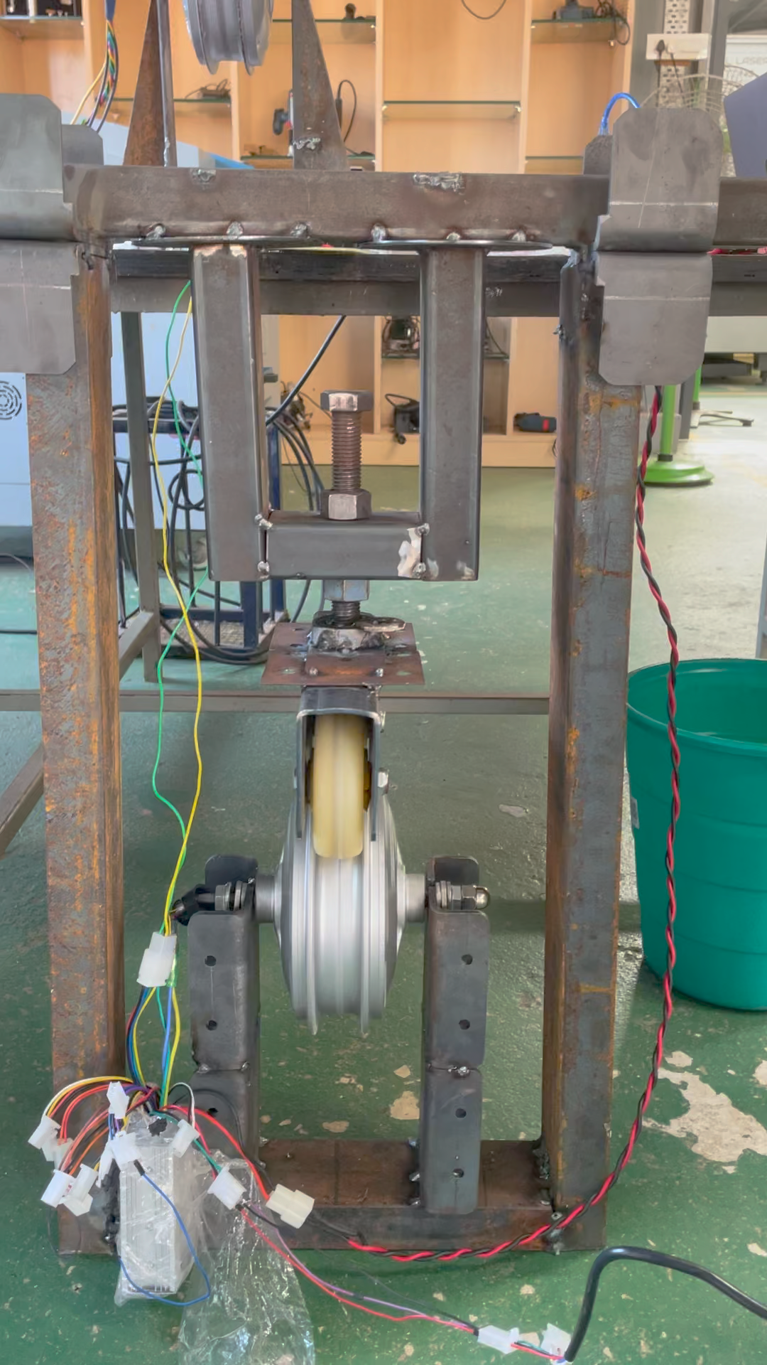
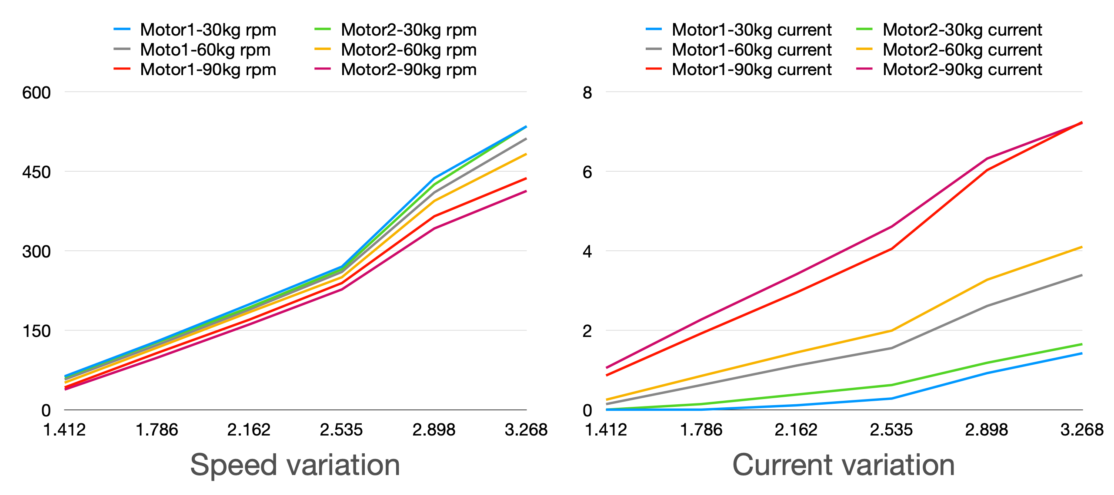
Load Test 30-60-90 kg

Slide 13
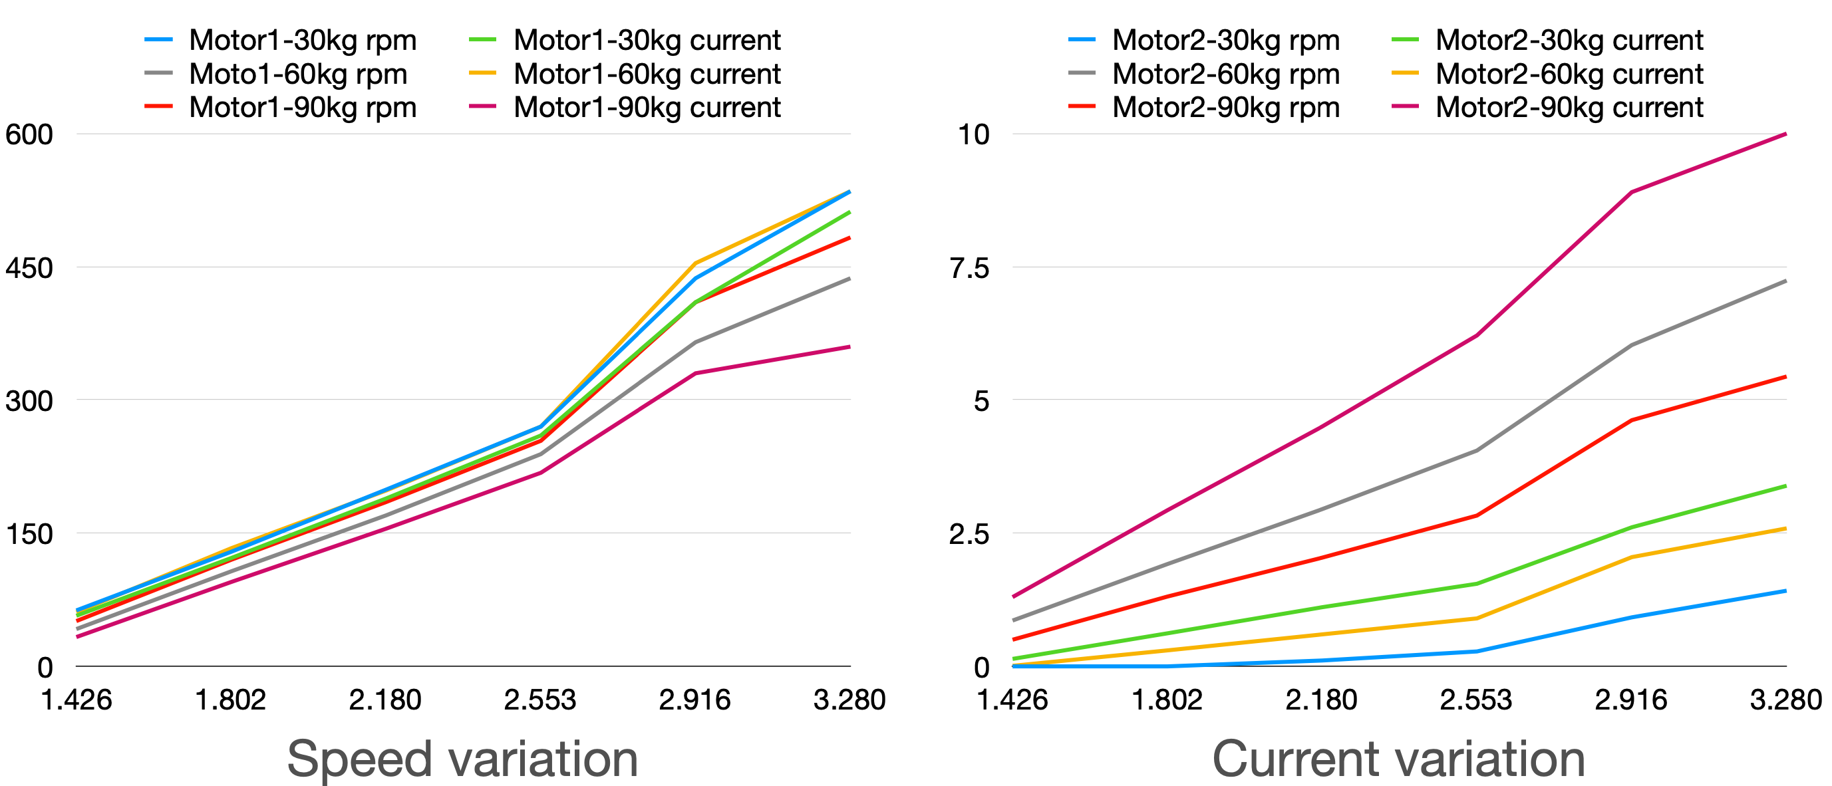
Load Test with different motor driver

Slide 14
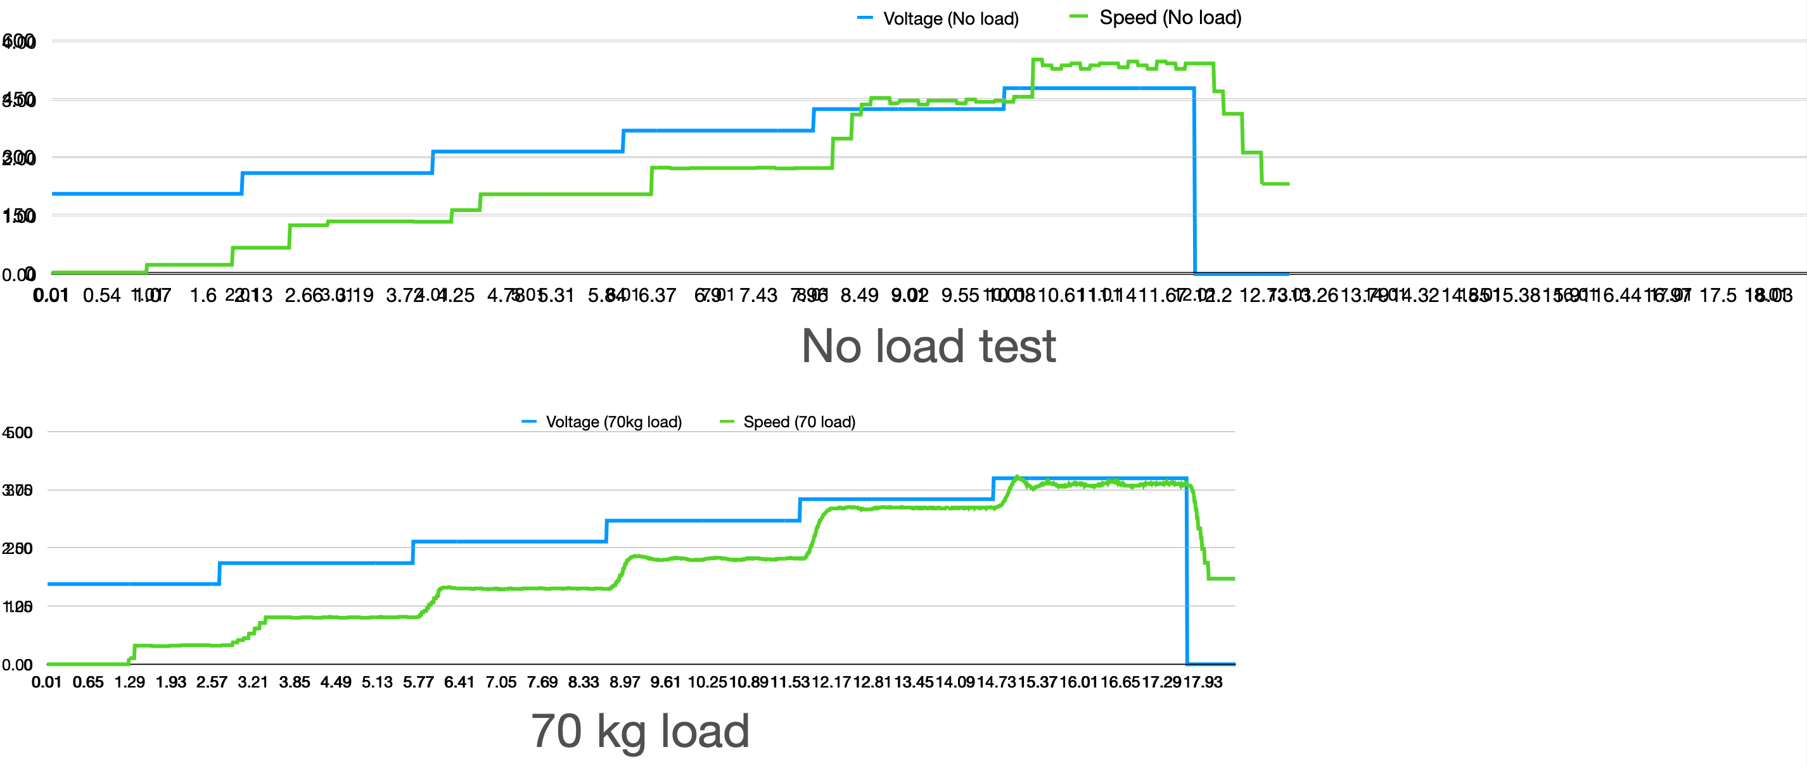
Motor 1 Latency test

